Slide 1
Smart Plug

Slide 2
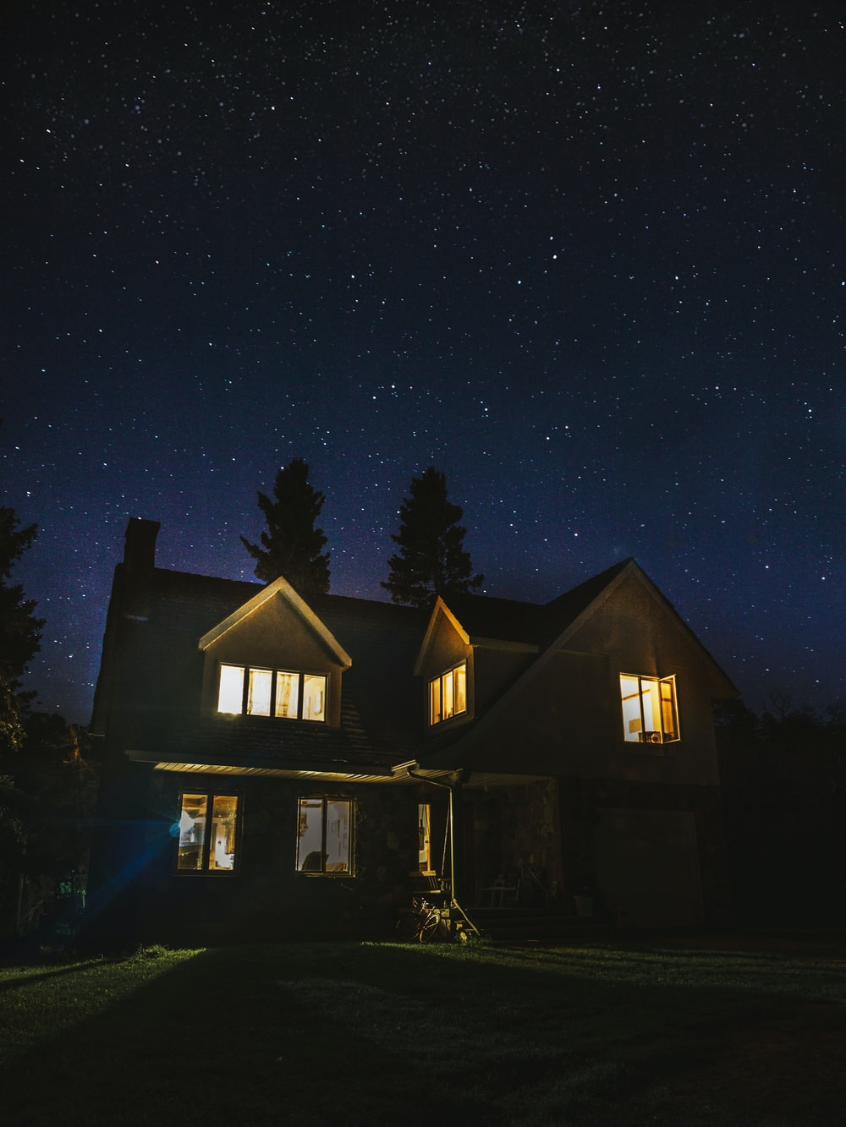
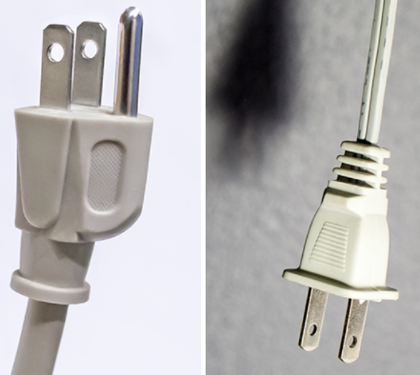
Introduction
Purpose
Long-distance control socket
Remote control the socket when there is no internet
Scope
All electrical appliances with plug
Use Case
Home

Slide 3
Requirements and Challenges
Lots of research
Long Distance
No WiFi and Bluetooth
Able to use without network
Notes:
The product on the market’s disadvantages.

Slide 4
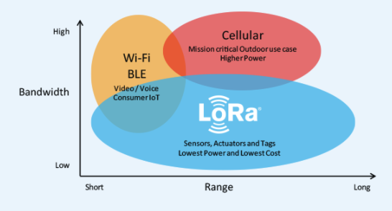
Lora （Long Range)
Semtech
ISM Frequency: 433, 868(EU), 915(US) MHz
Characteristic: long-range transmissions and low power consumption.
It covers the physical layer.
¼ miles.
Notes:
LoRaWAN (Long Range Wide Area Network) cover the upper layers. It can achieve data rates between 0.3 kbit/s and 27 kbit/s, depending upon the spreading factor.

Slide 5
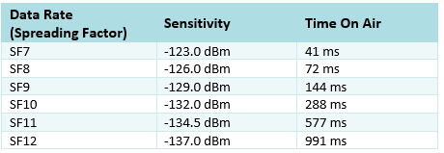
1. Spreading Factor(SF)
Range 6 - 12
LoRa has the fastest data transmission rate when SF is 6.
If SF = 6 , 1 = 1 to 1 = 111111
Increase of SF will cause:
Lower data transmission rate
Reduce bit error rate
Stronger the anti-interference ability
Notes:
After been spreading the original data volume will time the SF number. Spreading Factor decides on how many chirps, the carrier of the data, are sent per second.
Three most important parameter for Lora

Slide 6
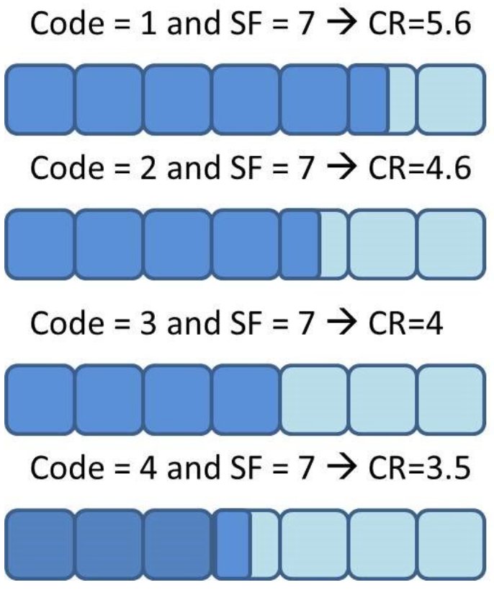
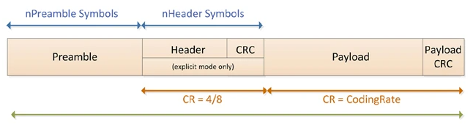
2. Code Rate (CR)
If CR is ⅘, means 4 valid data and 1 extra data order to stronger the anti-interference ability.
Cyclic redundancy check(CRC)
10100 -> 01010 -> 00101 -> 10010 -> 01001 -> 10100
Notes:
CR expresses what part of the redundant message is actually meaningful.

Slide 7
3. Bandwidth (BW)
BW = Higher limit of frequency minus lower limit of frequency.
BW increase will cause effective data rate increase in order to shorten the transmission time.
Notes:
Symbol rate (Rs) = BW/(2^SF)
Data rate (DR)= SF*( BW/2^SF)*CR

Slide 8
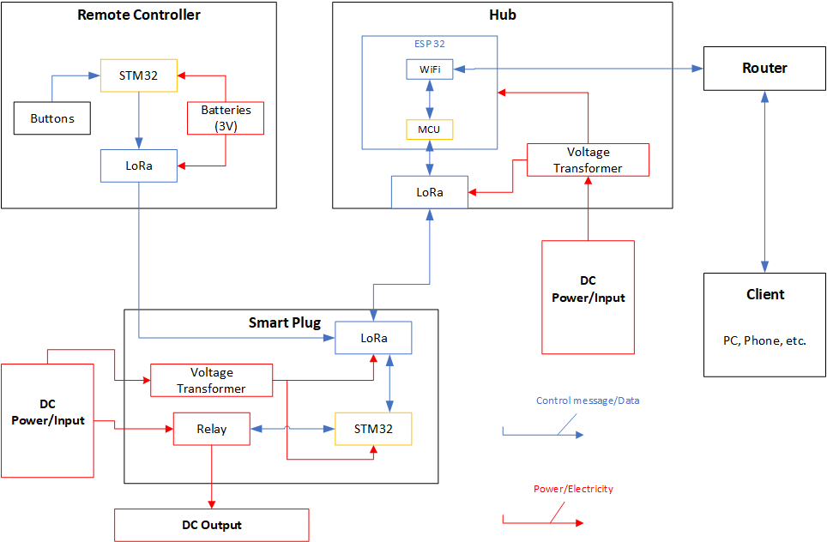
System Block Diagram

Slide 9
Subsystems
Plugs
Remote controller
Hub
Router, clients.

Slide 10
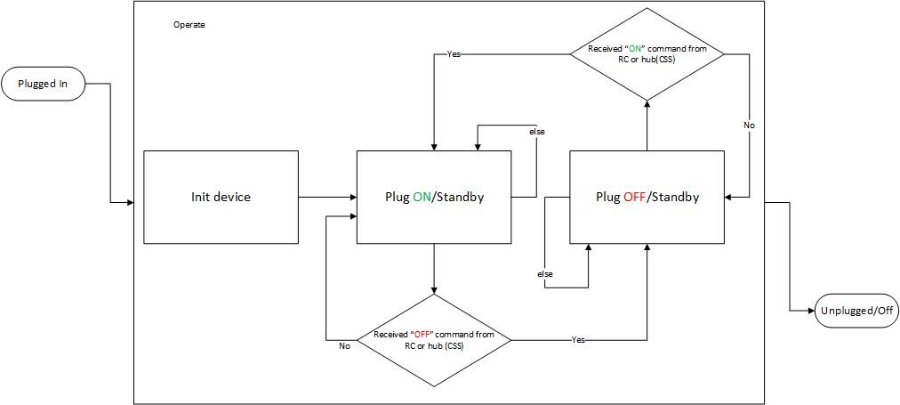
Functional Block Diagram - Plugs

Slide 11
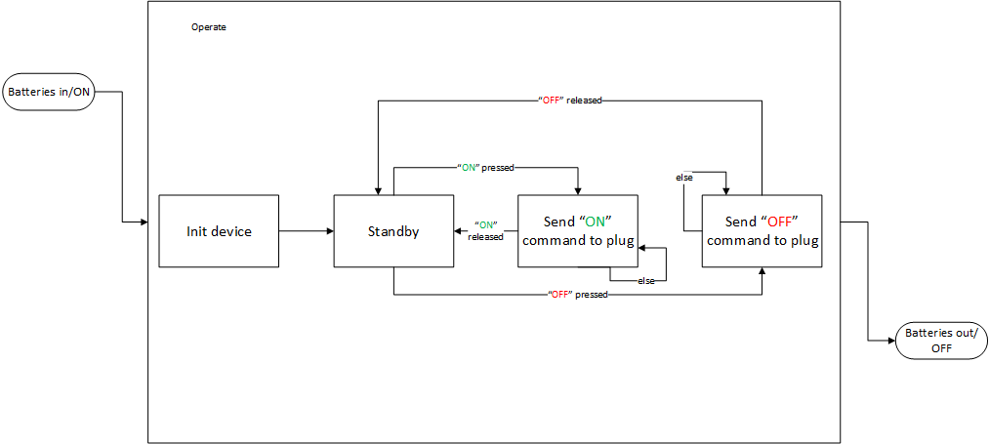
Functional Block Diagram - Remote Controller

Slide 12

Functional Block Diagram - Hub

Slide 13
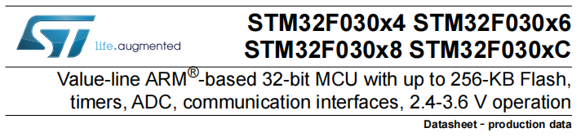
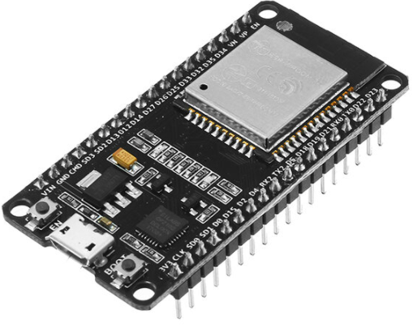
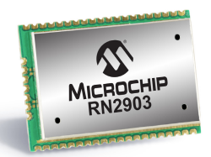
Hardware Implementation Plan
STM 32 (ARM Architecture)
ESP 32 (Arduino IDE)
Microchip RN2903
Notes:
Eps32: 2.4GHz Dual-Mode WiFi
Microchip RN2903: 2.1-3.6V, Temperature Range: -40°C to +85°C

Slide 14
Software Implementation Plan
Goal:
-Provide an abstraction to people who use it
-General LoRa platform
Library & IDE:
Currently on Arduino, from scratch, for simple verification
Move to Keil, SX1678.h
XCode
Connectivity:
Hub APP on iOS (require further study)
Notes:
Goal:
Obvious to user
Make it more general, after all outlet is only one of the IOT ideas
so that can be expand to other IOT
Preliminary efforts mainly on basic function implementation
To get a basic map,
about how modules function,
how they work together,
are they functions as what we anticipated
For Connectivity, build an app on mobile phone,
get control of all the IOT devices, say smart plugs in our project

Slide 15
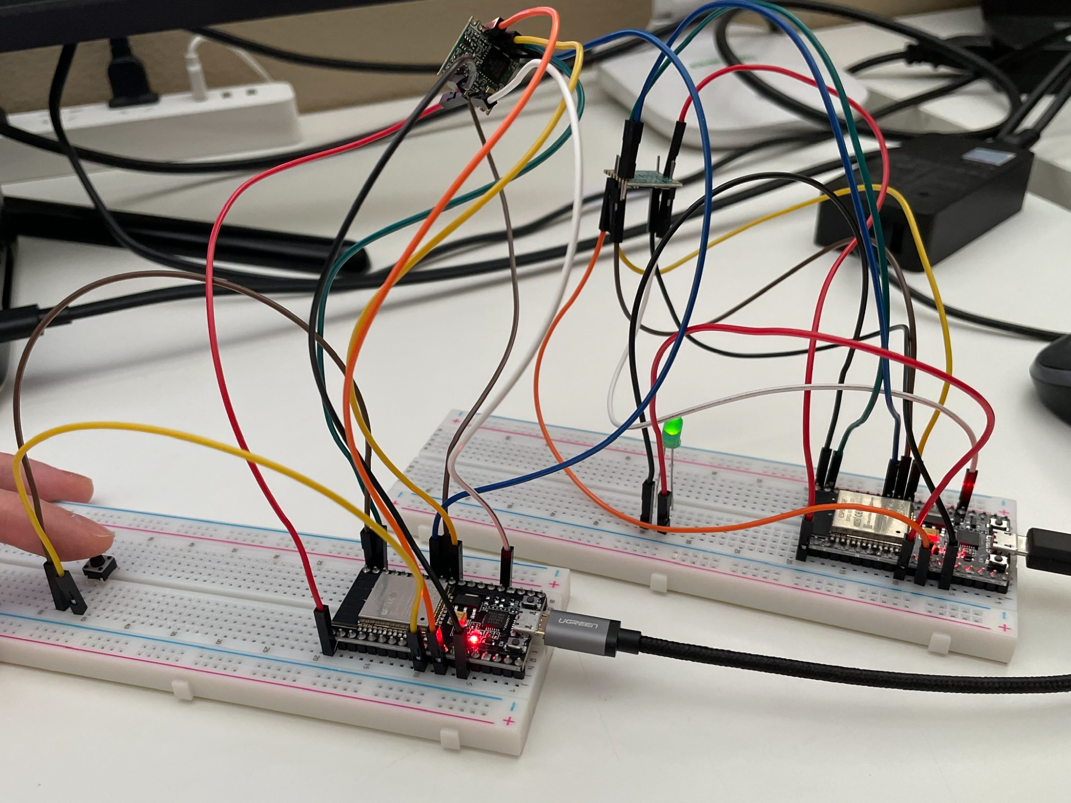
Preliminary Progress
Sending Simple Control Message end-to-end with LoRa
Limitation:
Loss
Not Exchange
Black Box
Next:
Get into details(libs, tools)
Build a network
https://drive.google.com/file/d/10ILMhW--fJjJzc0_kFHn_t-Pv1JEiAte/view?usp=sharing
Notes:
Loss happen when sending in a high frequency
Trying to implement message exchange
Black Box to us because we are using Arduino IDE as preliminary implementation, to get a quick prototype of our project
Get into the Move to pro tools

Slide 16
Validation Plan
Expect Result
Multiple Ways of Control: HUB & Button
Long Range, Stable, Controllable
Performance Assess：
Communication Robustness: range, loss rate
Testing Procedures
Range Signal Strength
Notes:
Robustness: try no loss, or assess loss make sure loss happen in a acceptable range
Range: in lab, super close each other how far away it can perform
Multiple control ways:
internet through hub (connectivity)
Remote control simply using physic signal like button pressed(what scenario LoRa suppose to be used)

Slide 17
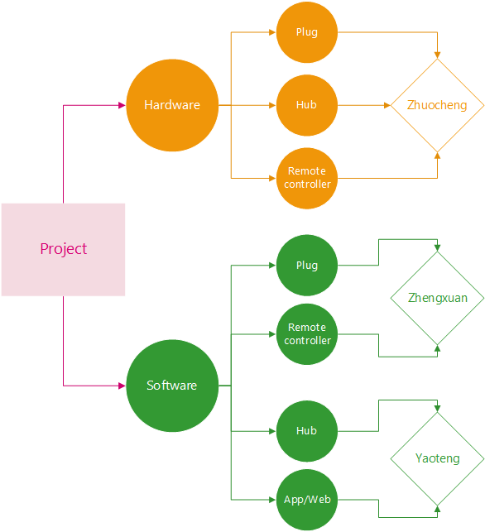
Work Distribution

Slide 18
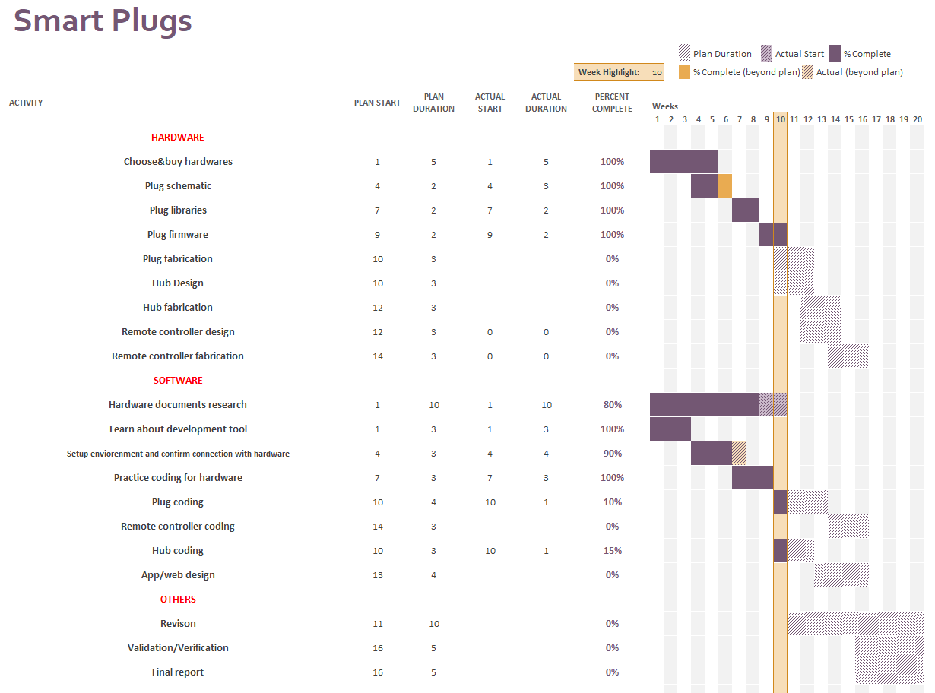
Gantt Chart

